Slide 1







Lesson 5:
Find the Bug

Slide 2
Slide

Slide 3
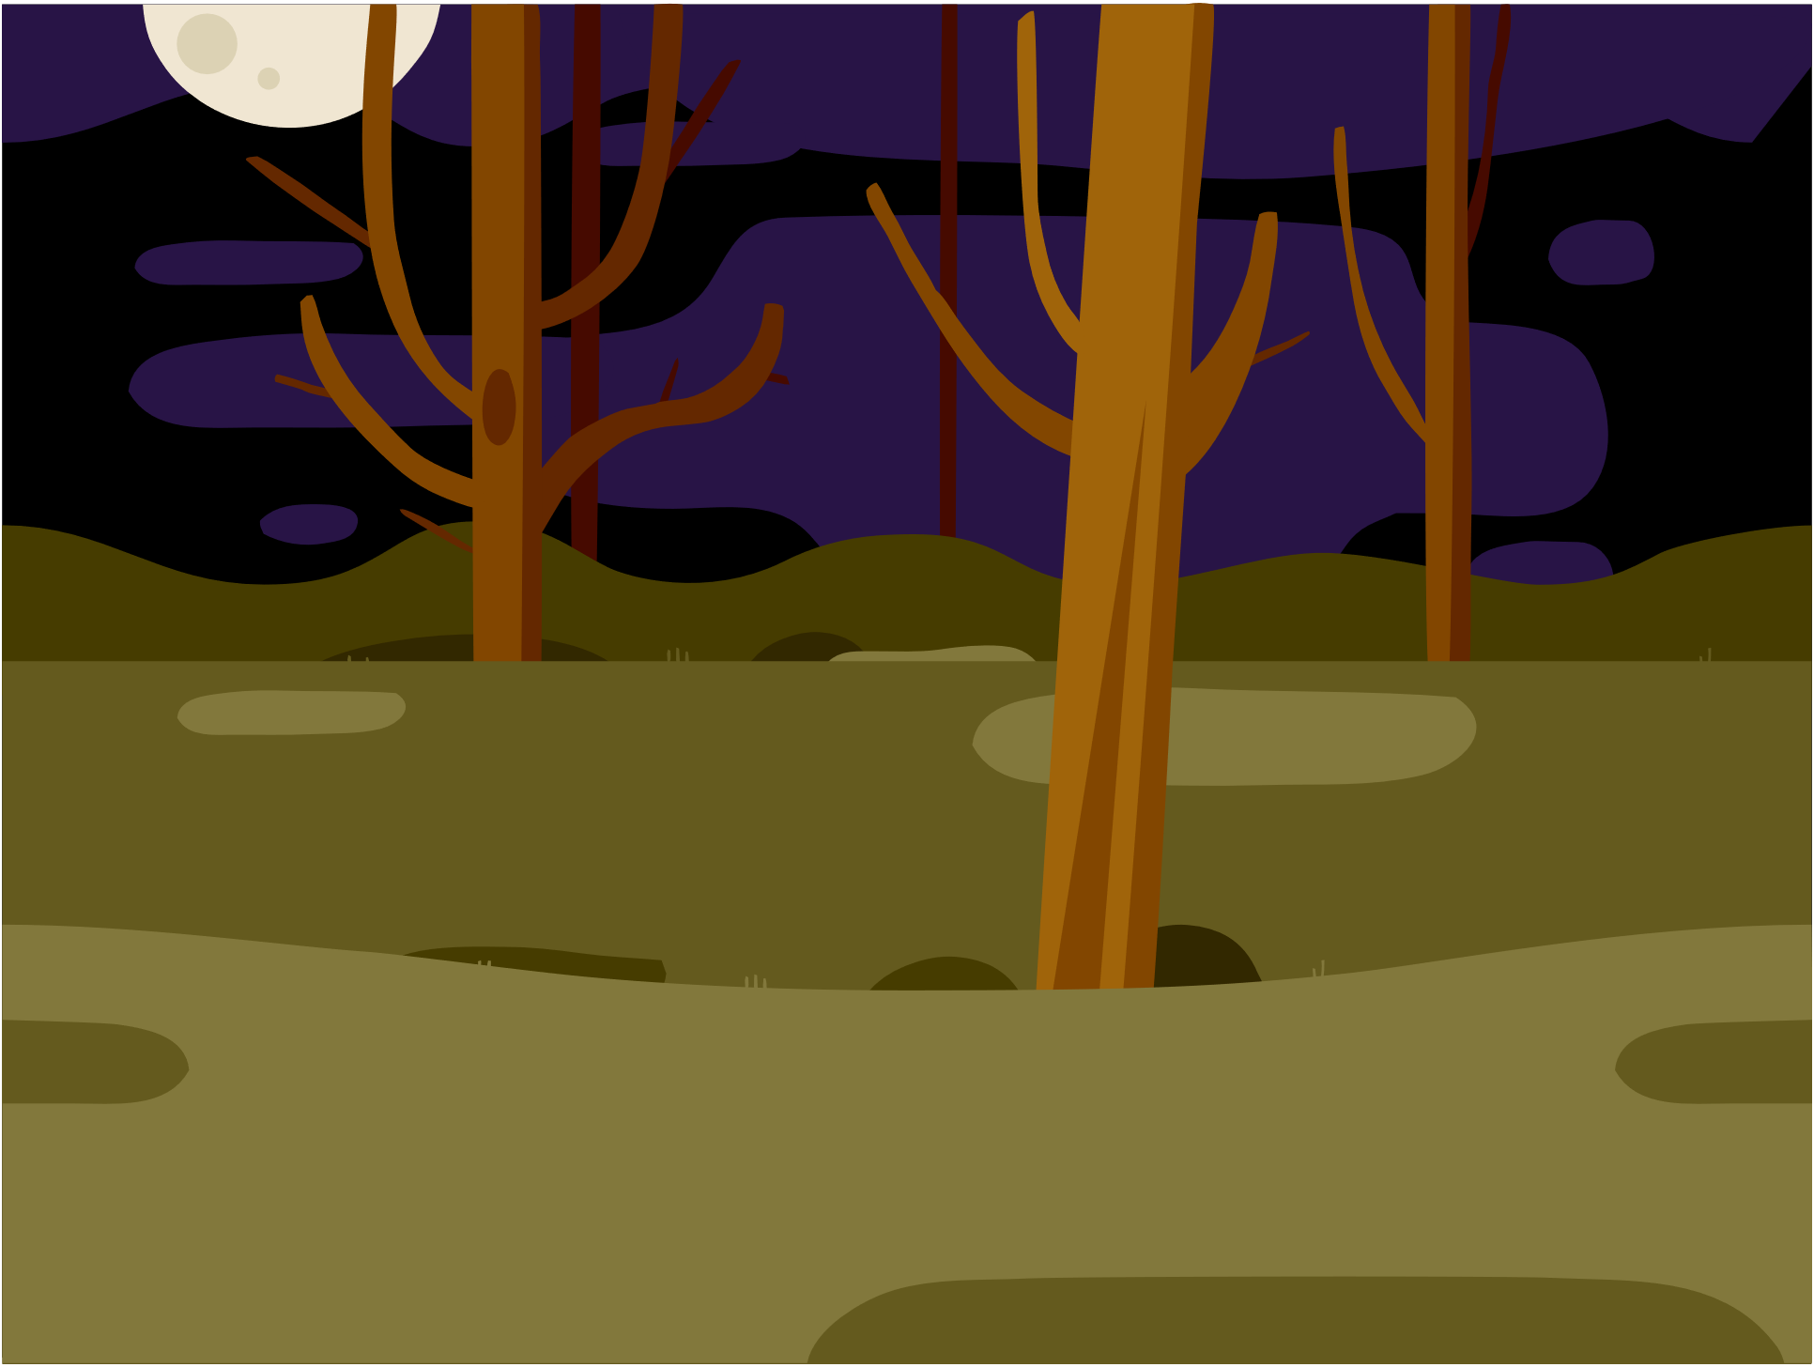

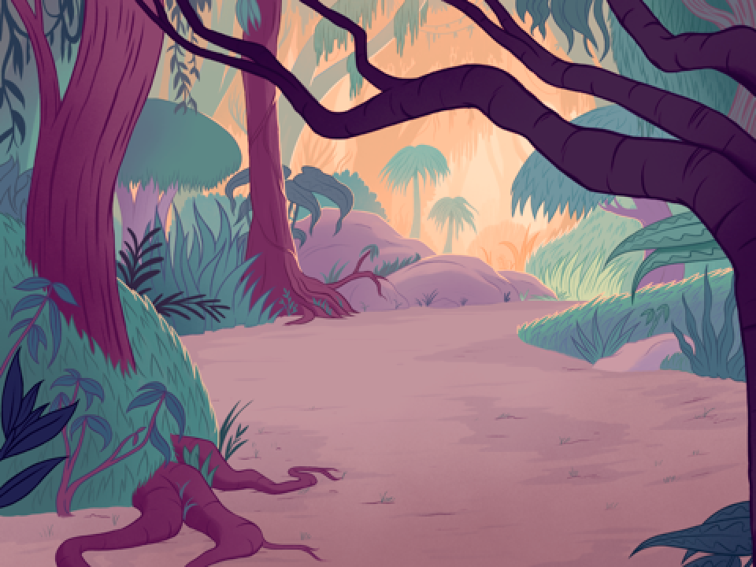
Three Levels
1st Level: Woods
2nd Level: Farm
3rd Level: Jungle
Each is a different Backdrop of the Stage

Slide 4
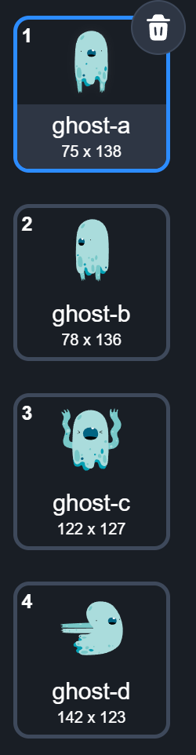
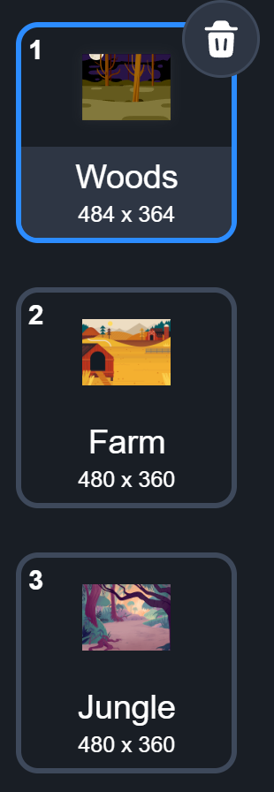
Backdrops Are Stage’s Costumes
Sprite has costumes
Stage has backdrops

Slide 5
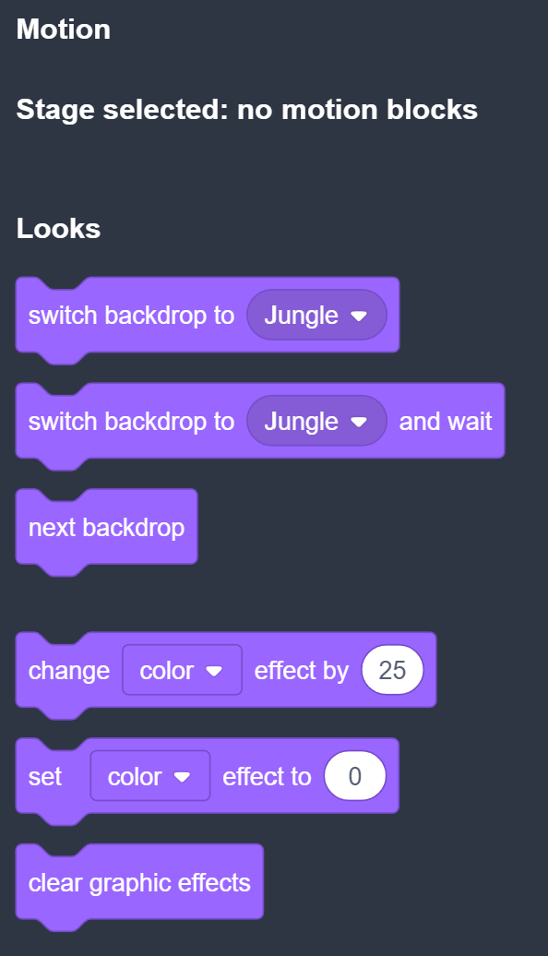
Code Blocks For Stage
No Motion blocks for Stage. Well, you don’t want to move the Stage anyway!

Slide 6
Change Backdrop For Stage
Look familiar?

Slide 7




Change Backdrop For Stage
Sprites
Stage
Stage is a special sprite

Slide 8
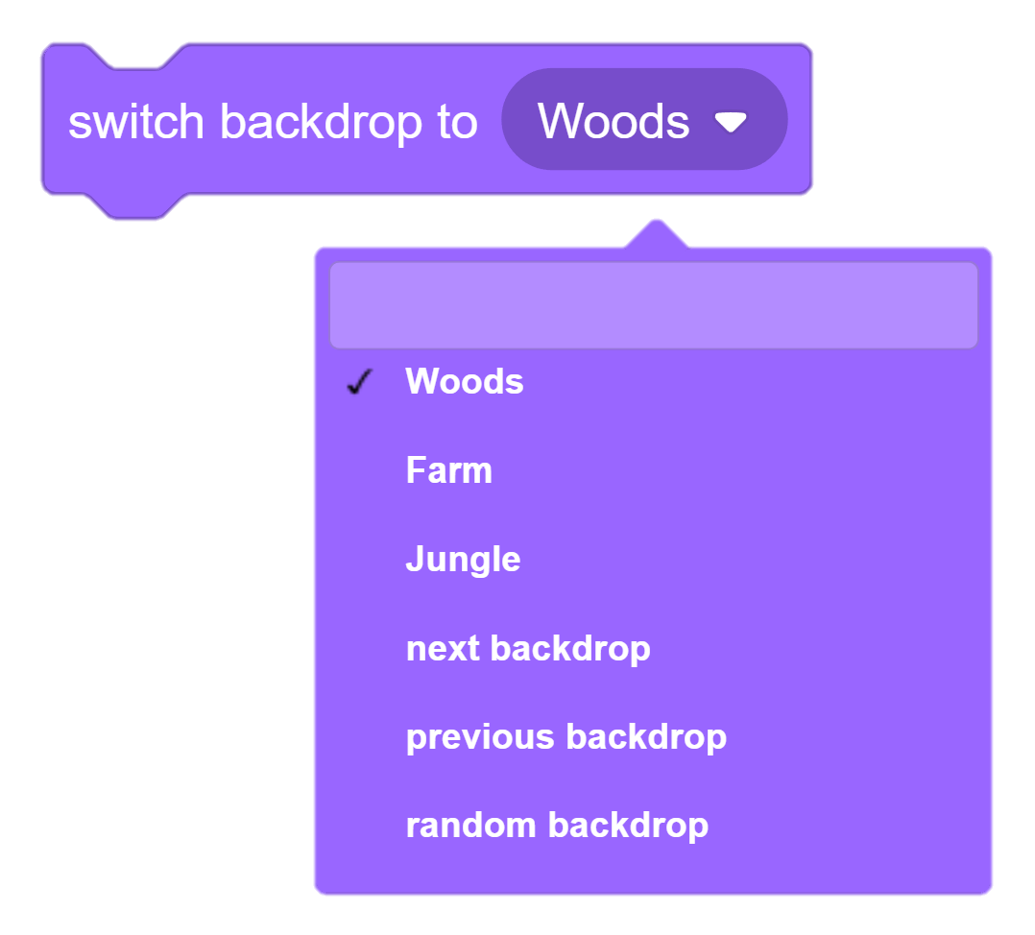
Change Backdrop For Stage

Slide 9
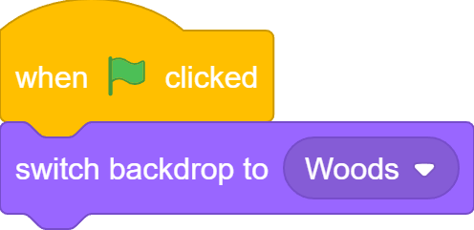
Start with Level1

Slide 10
Rename Backdrops
Woods → Level1
Farm → Level2
Jungle → Level3

Slide 11

Ladybug Sprite
Ladybug2

Slide 12

Click the Bug!

Slide 13
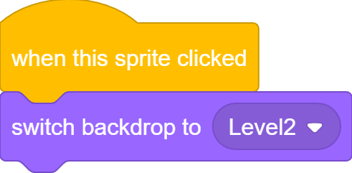
Move to Next Level
Level1
Level2

Slide 14

Move to Next Level
Level2
Level3

Slide 15
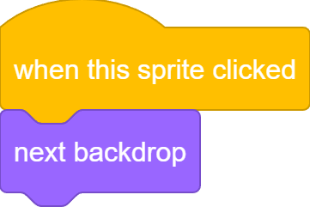
Move to Next Level
Level1
Level2
Level3

Slide 16
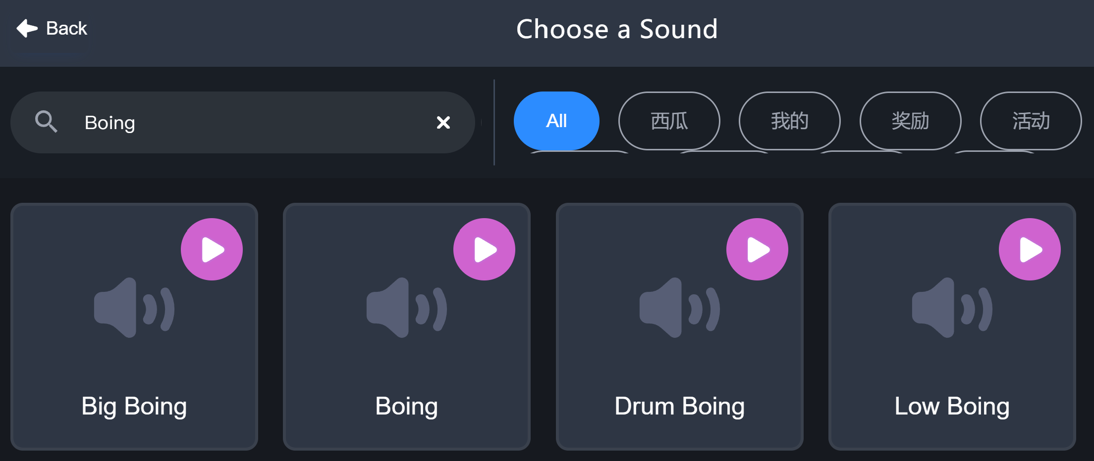
Make Some Noise!

Slide 17

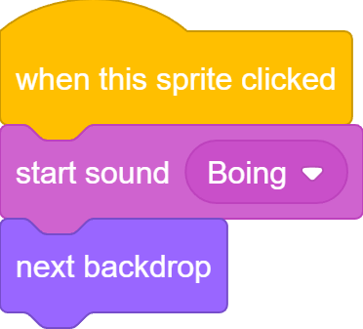
Make Some Noise!

Slide 18
Make It Harder – Random Position
The game is too easy! Bug shows up at the same position in each level

Slide 19
Show Up Randomly
Instead, we want the bug to be at random position in each level

Slide 20

Show Up Randomly
Go to random position is easy, the question is WHEN?

Slide 21
Show Up Randomly
When switch to a new backdrop, go to random position

Slide 22


Show Up Randomly
When Go button is clicked, we do …
When sprite is click is clicked, we do …

Slide 23

Show Up Randomly
When backdrop switches to Level1/Level2/Level3 , we do…

Slide 24
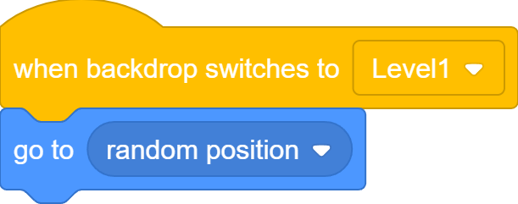


Show Up Randomly

Slide 25
Make It Harder – Smaller Bug
Bug is too big and too easy to find!

Slide 26



Set Sprite Size

Slide 27
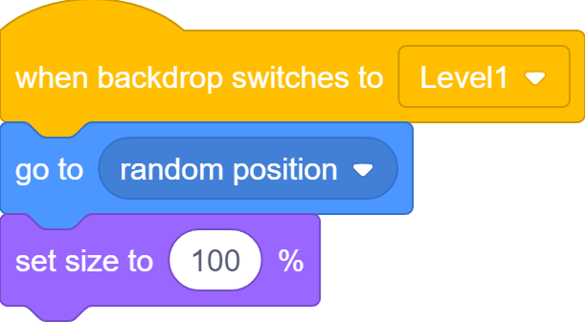
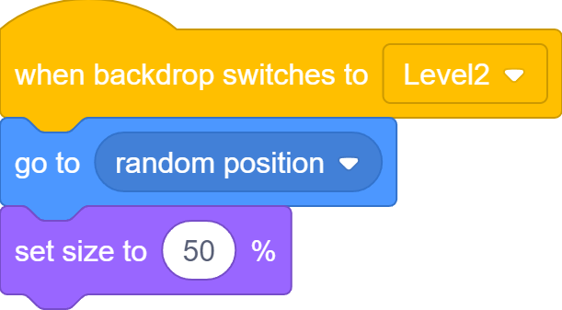

Smaller and Smaller Bug

Slide 28
End Screen
End Screen

Slide 29
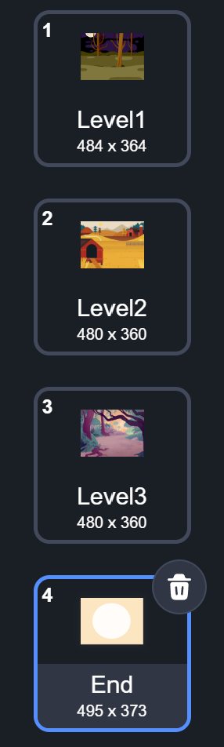
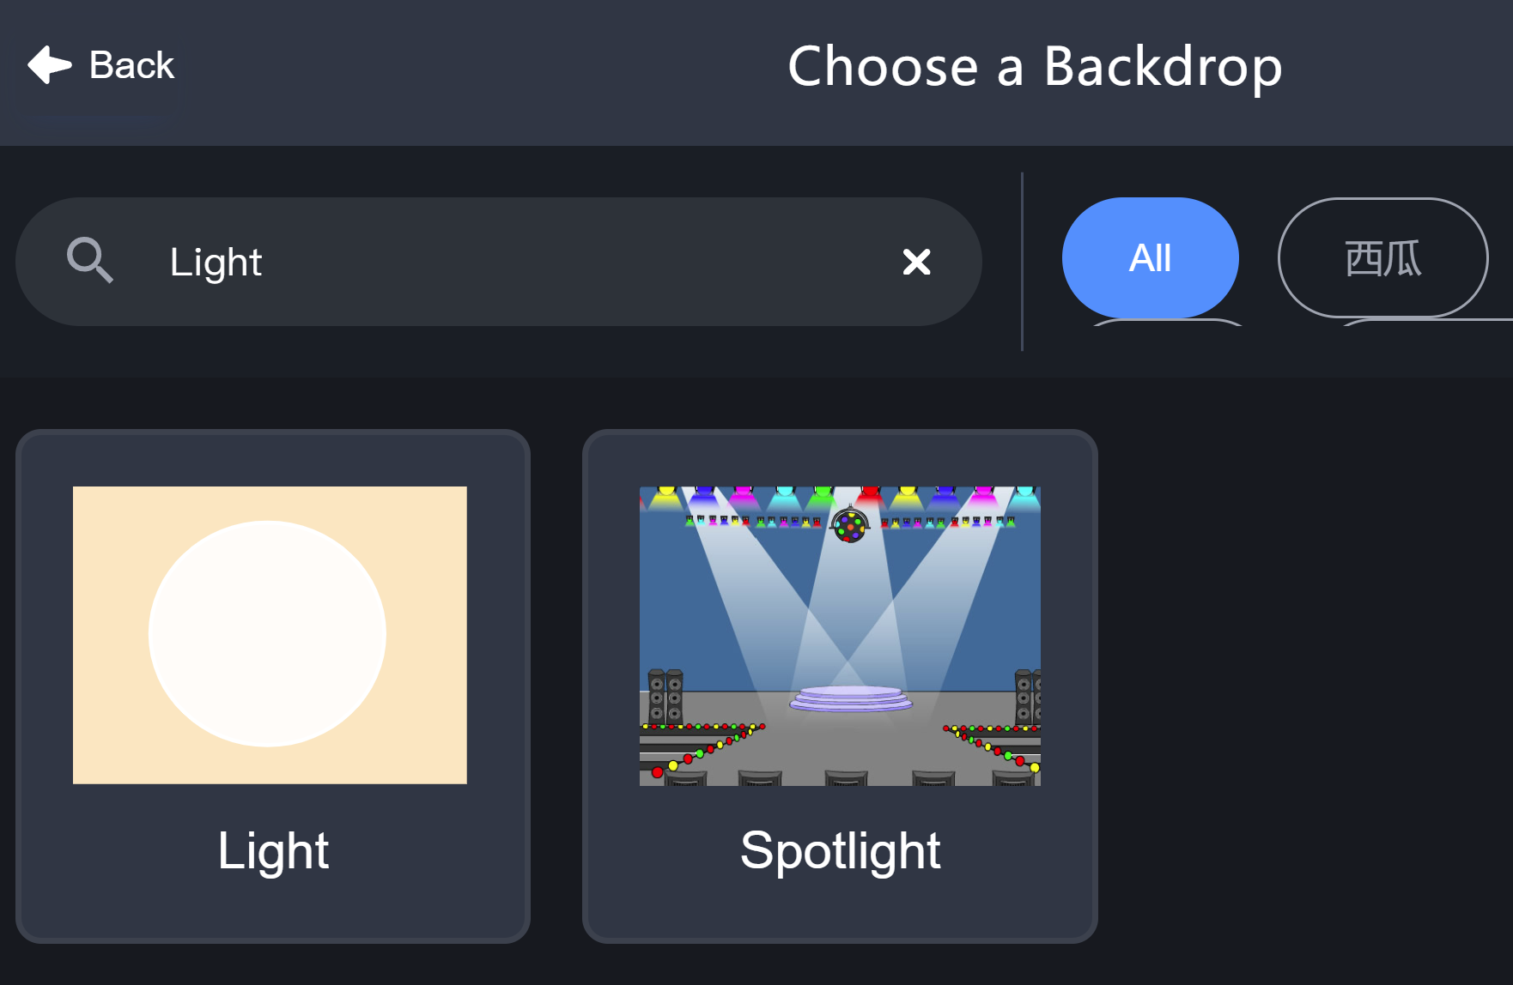
End Screen

Slide 30

End Screen

Slide 31
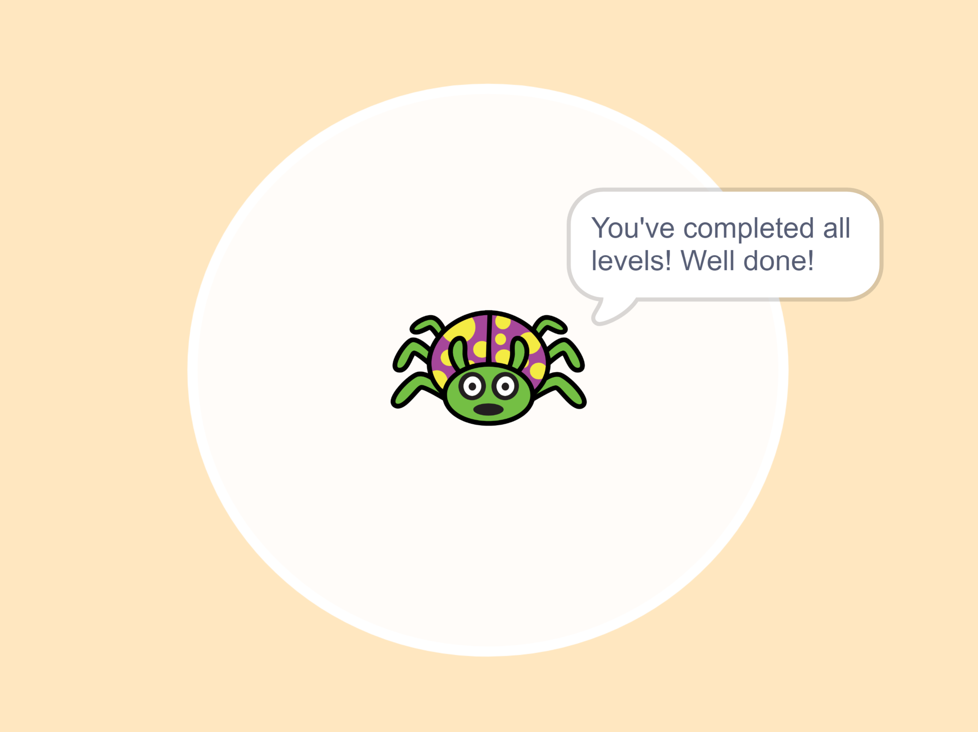
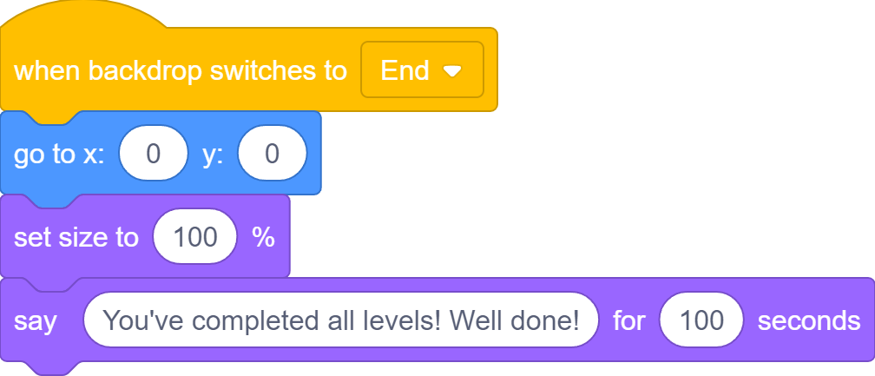
Congratulations!

Slide 32
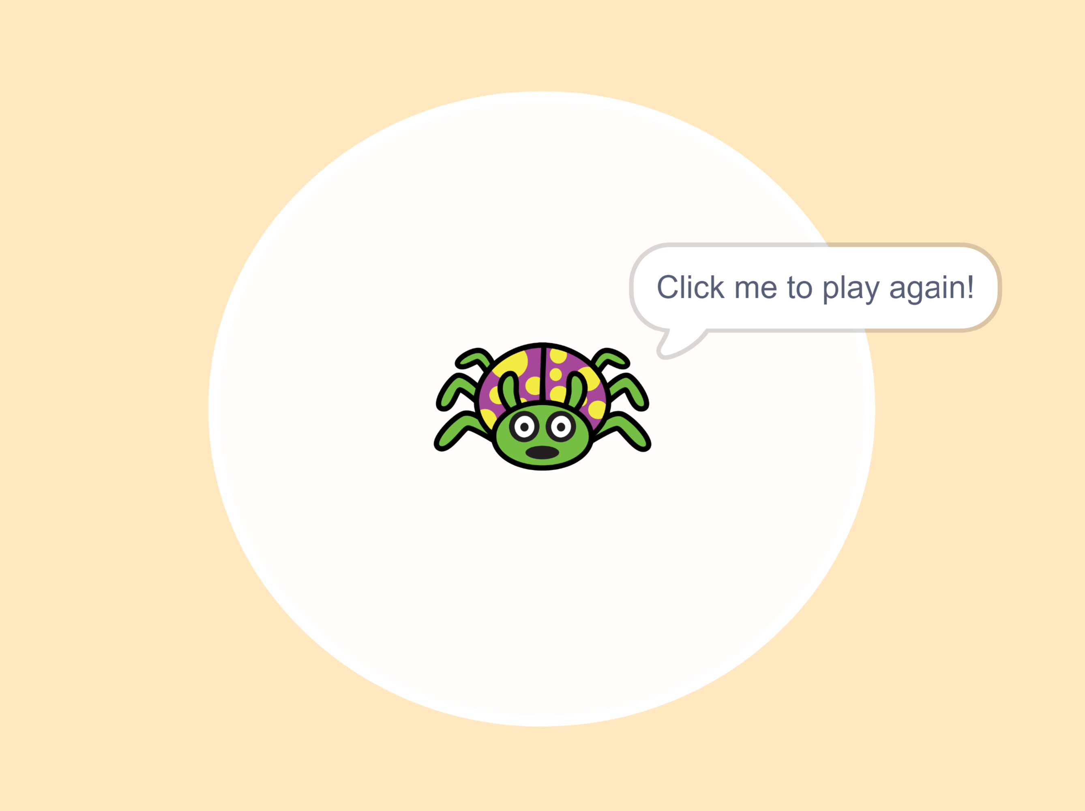
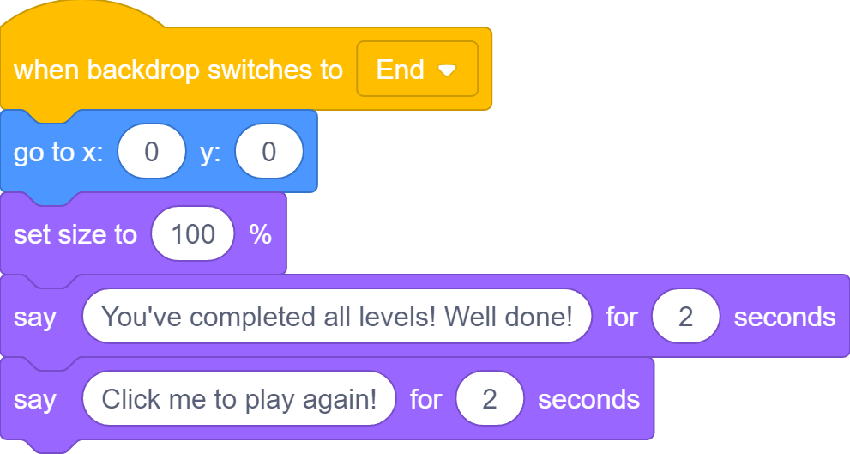
Restart the Game

Slide 33
Restart the Game

Slide 34





Time the Game
Start: 0
Finish: 30
Total time: 30 seconds

Slide 35



Timer Block

Slide 36

Time the Game
Click Go button to reset and start timer
0.000
3.417
7.629
9.137

Slide 37


Report the Time
Rectangle block with rounded corners can be put inside rectangle slots with rounded corners

Slide 38
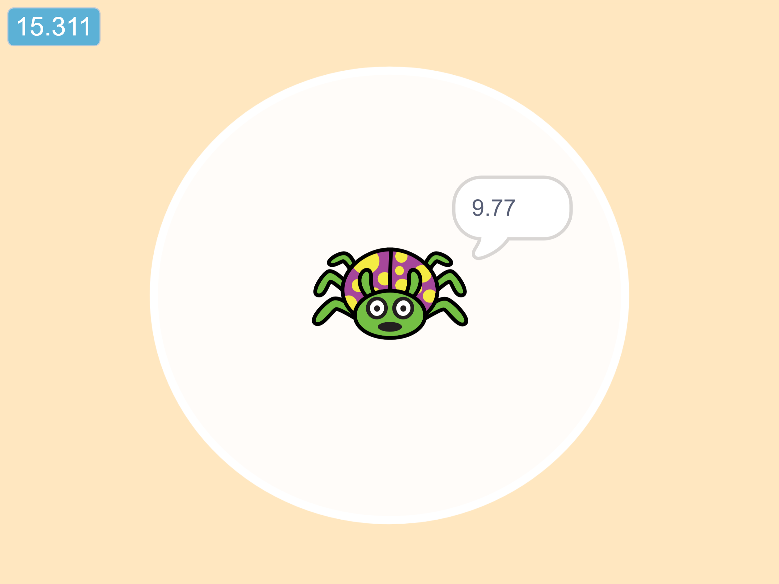
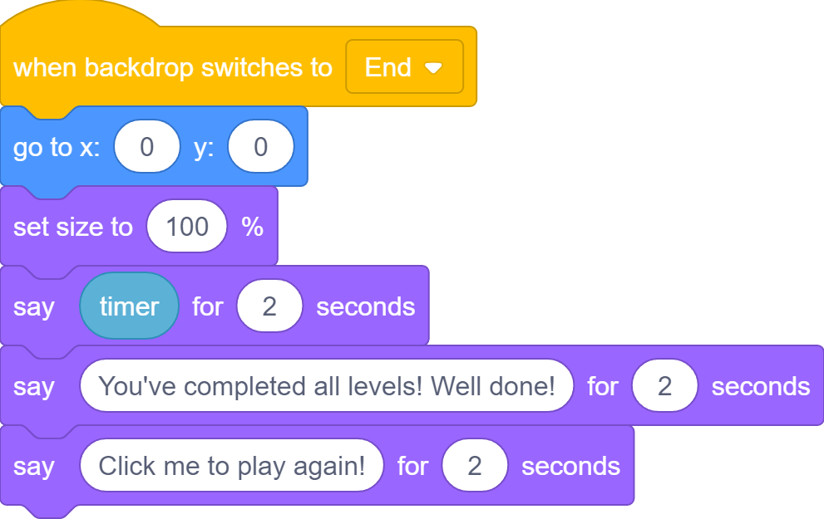
Report the Time

Slide 39
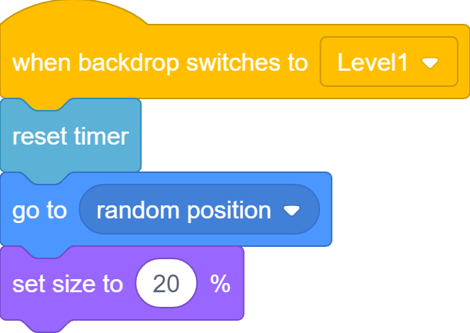
Reset Timer
9.137
0.000
Reset timer

Slide 40
What we learnt…
How to change sprite size using block

Slide 41
Exercises
How can you make the ghost fade out/in faster/slower?
Explore with other graphic effects and see what each one

Slide 42
Thank you and see you in the next lesson!

